Slide 1

Poisson Distribution
Number of Events

Slide 2
Binomial – Recap Problem 1
1. You are performing a cohort study. If the probability of developing disease in the exposed group is .05 for the study duration, then if you (randomly) sample 500 exposed people, how many do you expect to develop the disease? Give a margin of error (+/- 1 standard deviation) for your estimate.
2. What’s the probability that at most 10 exposed people develop the disease?

Slide 3
Answer
1. How many do you expect to develop the disease? Give a margin of error (+/- 1 standard deviation) for your estimate.
X ~ binomial (500, .05)
E(X) = 500 (.05) = 25
Var(X) = 500 (.05) (.95) = 23.75
StdDev(X) = square root (23.75) = 4.87
25 ± 4.87

Slide 4
Answer
2. What’s the probability that at most 10 exposed subjects develop the disease?
This is asking for a CUMULATIVE PROBABILITY: the probability of 0 getting the disease or 1 or 2 or 3 or 4 or up to 10.
P(X≤10) = P(X=0) + P(X=1) + P(X=2) + P(X=3) + P(X=4)+….+ P(X=10)=

Slide 5
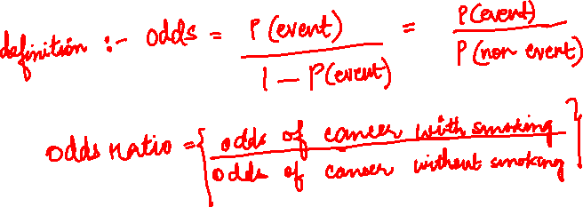
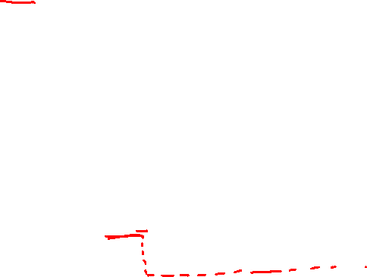
Binomial – Recap Problem 2
In your case-control study of smoking and lung- cancer, 60% of cases are smokers versus only 10% of controls. What is the odds ratio between smoking and lung cancer?
a. 2.5
b. 13.5
c. 15.0
d. 6.0
e. .05

Slide 6
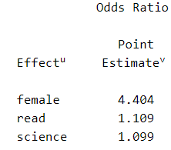
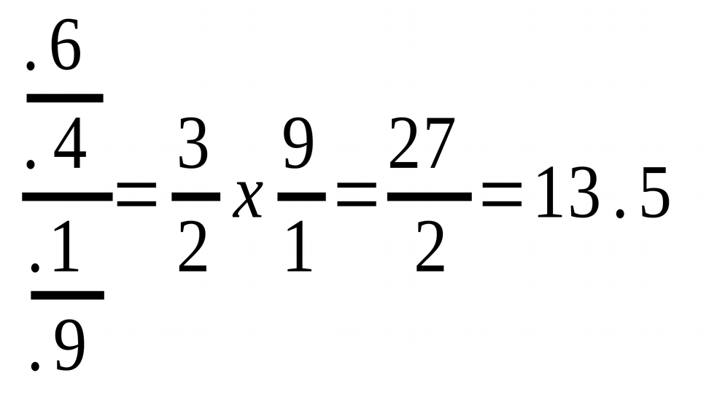
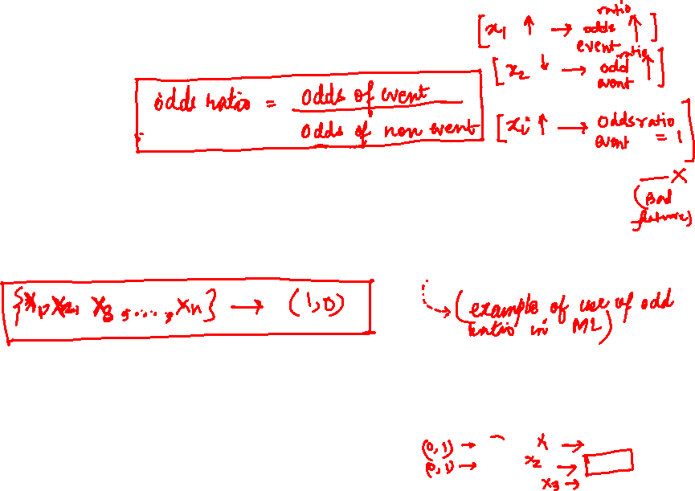
Answer
In your case-control study of smoking and lung- cancer, 60% of cases are smokers versus only 10% of controls. What is the odds ratio between smoking and lung cancer?
a. 2.5
b. 13.5
c. 15.0
d. 6.0
e. .05

Slide 7
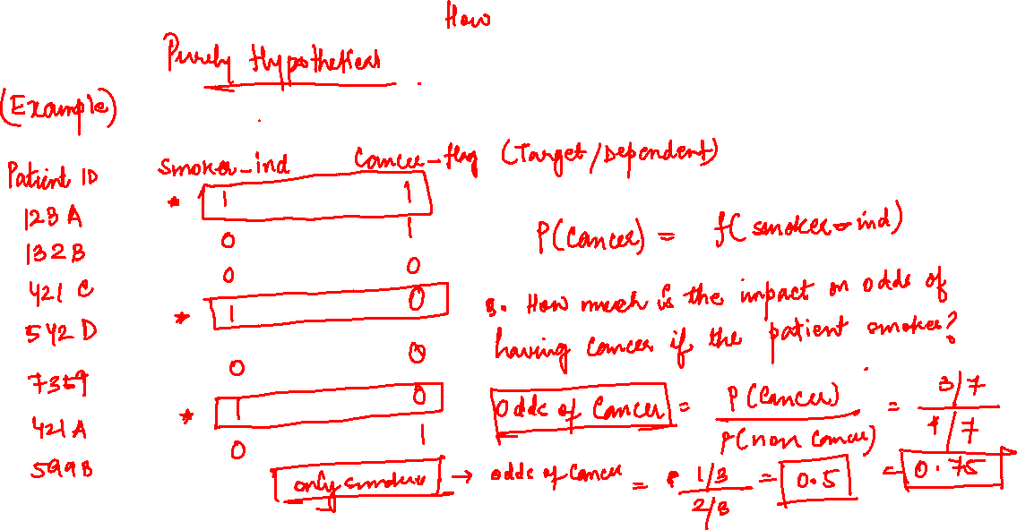
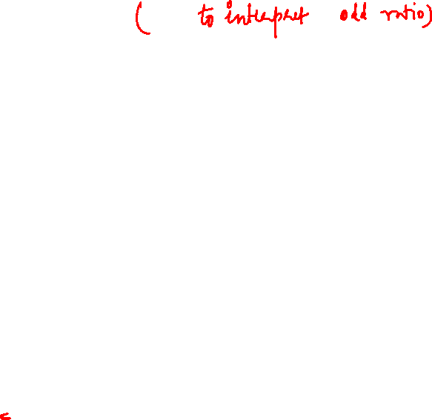

Slide 8
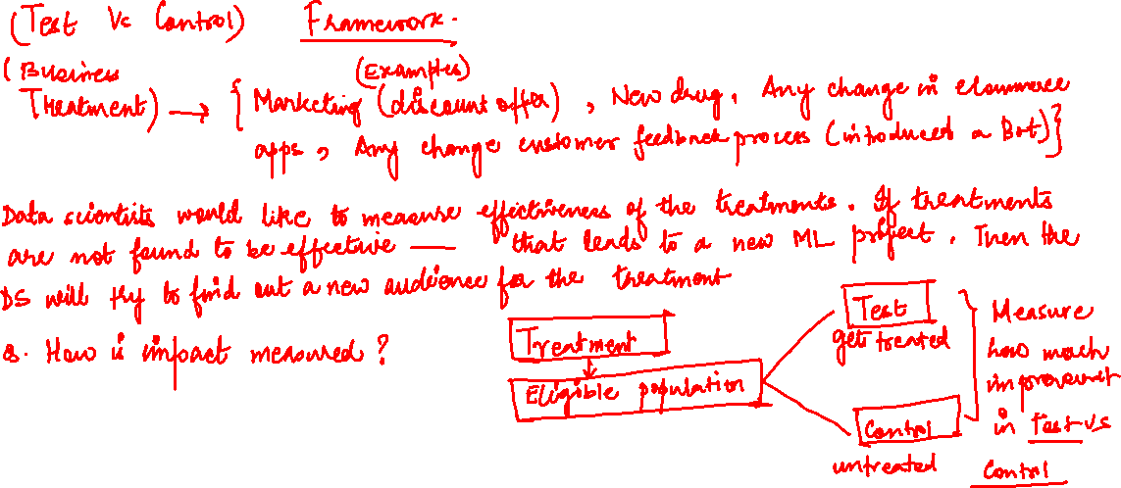

Slide 9
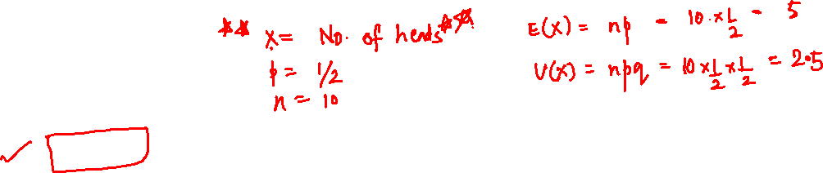
Binomial – Recap Problem 3
If I toss a coin 10 times, what is the expected value and variance of the number of heads?
a. 5, 5
b. 10, 5
c. 2.5, 5
d. 5, 2.5
e. 2.5, 10

Slide 10
Poisson Distribution
Poisson distribution is for counts—if events happen at a constant rate over time, the Poisson distribution gives the probability of X number of events occurring in time T.

Slide 11
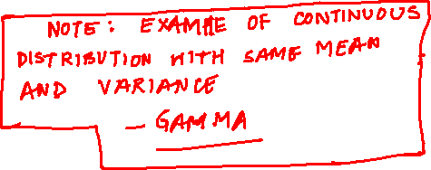
Poisson Mean and Variance
Mean
μ =λ
For a Poisson random variable, the variance and mean are the same!
Variance and Standard
Deviation
σ ² =λ
σ = λ
where λ = expected number of hits in a given time period

Slide 12
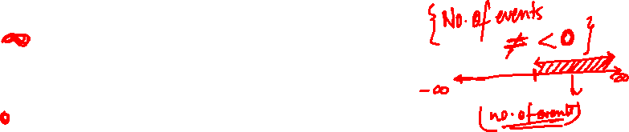
Poisson Distribution – PMF
The Poisson distribution models counts, such as the number of new cases of SARS that occur in women in New England next month.
The distribution tells you the probability of all possible numbers of new cases, from 0 to infinity.
If X= # of new cases next month and X ~ Poisson (λ), then the probability that X=k (a particular count) is:
_{λ}k _{e}− λ
p( X =k ) =
k!

Slide 13
Example
For example, if new cases of West Nile Virus in New England are occurring at a rate of about 2 per month, then these are the probabilities that: 0,1, 2, 3, 4, 5, 6, to 1000 to 1 million to… cases will occur in New England in the next month:

Slide 14


Poisson Probability table
X | P(X)
0 | ₂ 0 _{e} − 2 0! | =.135
1 | ₂1 _{e} − 2 1! | =.27
2 | ₂ 2 _{e} − 2 2! | =.27
3 | ₂ 3 _{e} − 2 3! | =.18
… | …

Slide 15
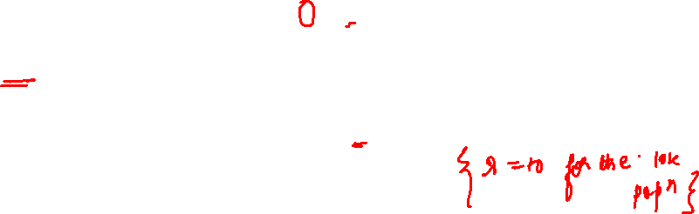
Example : Poisson
Suppose that a rare disease has an incidence of 1 in 1000 person- years. Assuming that members of the population are affected independently, find the probability of k cases in a population of 10,000 (followed over 1 year) for k=0,1,2.
The expected value (mean) =λ = .001*10,000 = 10 10 new cases expected in this population per year◊
₍₁₀₎0 _{e} − (10)
P( X =0) =
=.0000454
0!
₍₁₀₎1 _{e} − (10)
P( X =1) =
=.000454
1!
₍₁₀₎ 2 _{e} − (10)
P( X =2) =
=.00227
2!

Slide 16

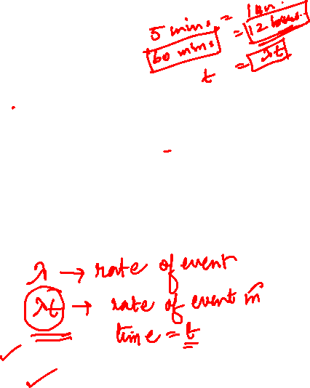
more on Poisson…
“Poisson Process” (rates)
Note that the Poisson parameter λ can be given as the mean number of events that occur in a defined time period OR, equivalently, λ can be given as a rate, such as
λ=2/month (2 events per 1 month) that must be multiplied by t=time (called a “Poisson Process”)
X ~ Poisson _{(λt)}
(λk)_{e}− λt
P( X =k ) =
k!
E(X) = λt
Var(X) = λt

Slide 17
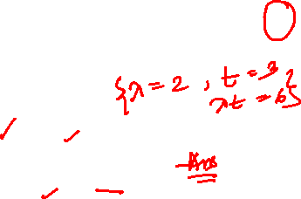
Example
For example, if new cases of West Nile in New England are occurring at a rate of about 2 per month, then what’s the probability that exactly 4 cases will occur in the next 3 months?
X ~ Poisson (λ=2/month)
_{(2 * 3)}4 _{e}− ( 2*3) ₆4 _{e}− (6)
P(X =4 in 3 months) = =
=13.4%
4!
4!
Exactly 6 cases?
P(X =6 in 3 months) =
_{(2 * 3)}6 _{e}− ( 2*3)
₆6 _{e}− (6)
=
=16%
6!
6!

Slide 18
Practice problems
1a. If calls to your cell phone are a Poisson process with a constant rate
λ=2 calls per hour, what’s the probability that, if you forget to turn your phone off in a 1.5 hour movie, your phone rings during that time?
1b. How many phone calls do you expect to get during the movie?

Slide 19
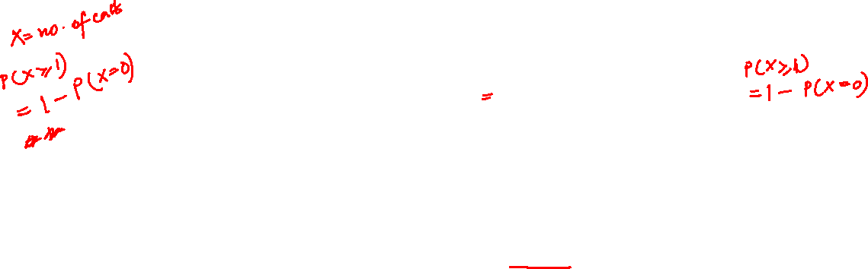
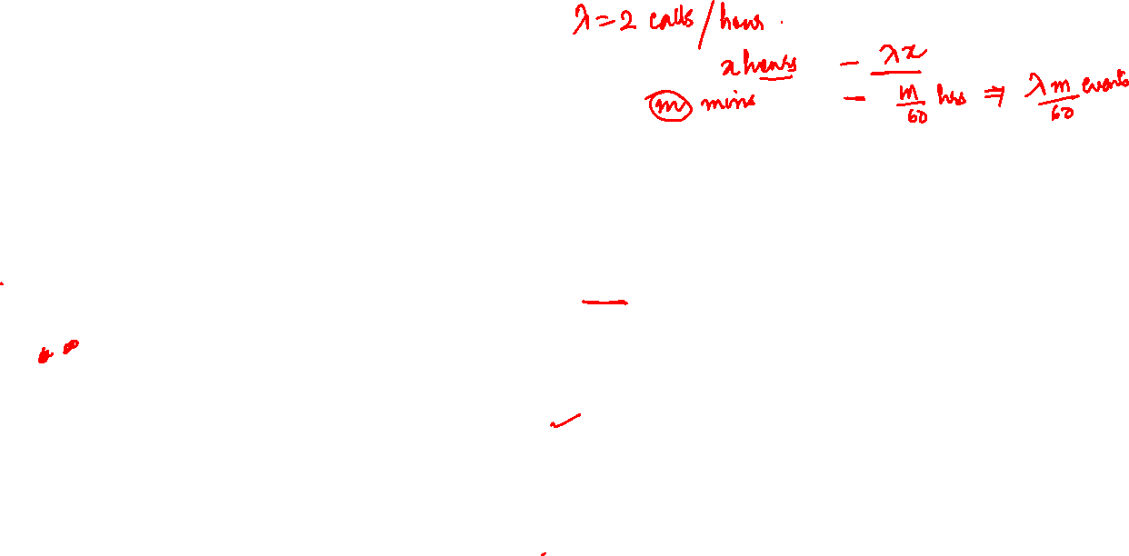
Answer
1a. If calls to your cell phone are a Poisson process with a constant rate λ=2 calls per hour, what’s the probability that, if you forget to turn your phone off in a
1.5 hour movie, your phone rings during that time?
X ~ Poisson (λ=2 calls/hour) P(X≥1)=1 – P(X=0)
_{(2 *1.5)}0 _{e}− 2(1.5)
(3)⁰ e⁻ ³
P( X =0) = =e
− 3
=.05
0! 0!
P(X≥1)=1 – .05 = 95%
chance
1b. How many phone calls do you expect to get during the movie?
E(X) = λt = 2(1.5) = 3

